Slide 1
Review:
Two Programming Paradigms
Structural (Procedural) Object-Oriented
PROGRAM PROGRAM
FUNCTION
OBJECT
Operations
Data
FUNCTION
OBJECT
OBJECT
Operations
Data
FUNCTION
Operations
Data
Function calls
Messages passing
Notes:
A list of tasks to perform.
Viewed as a collection of interacting objects. Each object can be viewed as an independent machine with a distinct role or responsibility. Operations are closely associated with the objects, carry their own operators around with them .

Slide 2
Review: Object-Oriented
Programming Language Features
1. Data abstraction
2. Inheritance of properties
3. Dynamic binding of operations to objects
Notes:
abstraction: a concept or idea not associated with any specific instance. virtual in C++, after declaration, it’s the responsibility of the programmer to implement a class to instantiate the object of the declaration

Slide 3
Object-Oriented Programming--
Introduction to Classes
Class Definition
Class Examples
Objects

Slide 4


What is an Object?
The real world is composed of different kinds of objects: buildings, men, women, dogs, cars, etc.
Each object has its own states and behaviors.
Behaviors
Color = Blue
Brand = Ferrari
Speed = 200 mph
Gear = 4
States
Changing
Gear
Steering
Accelerating
Braking
Variables and functions

Slide 5
Classes & Objects
The class is the cornerstone of C++
  It gives the C++ its identity from C
  It makes possible encapsulation, data hiding and inheritance
Class:
  Consists of both data and methods
  Defines properties and behavior of a set of entities
Object:
  An instance of a class
  A variable identified by a unique name
Notes:
Aim of class: a) provide the programmer with a tool for creating new types that can be used as conveniently as the built-in types (like float) b) user-defined type
why? Separate the incidental details of the implementation from the properties essential to the correct use of it
2. Derived class, templates: organizing related classes that allow the programmer to take advantage of their relationships.

Slide 6
Classes & Objects
class Rectangle
{
private:
int width;
int length;
public:
void set(int w, int l);
int area();
};
Rectangle r1;
Rectangle r2;
Rectangle r3;
……
int a;
Notes:
1. Now, still concrete, don’t differ much from built-in types. (actually no difference when used, only in the way they are created)
3. Class definition: class X {…}
3. Declaration vs. Definition

Slide 7
Define a Class Type
class class_name
{
permission_label:
member;
permission_label:
member;
...
};
class Rectangle
{
private:
int width;
int length;
public:
void set(int w, int l);
int area();
};
Header
Body

Slide 8
Class Definition-Data Members
Abstract the common attributes of a group of entities, their values determine the state of an object
Can be of any type, built-in or user-defined
non-static data member
  Each class object has its own copy
  Cannot be initialized explicitly in the class body
  Can be initialized with member function, or class constructor
static data member
  Acts as a global object, part of a class, not part of an object of that class
  One copy per class type, not one copy per object
  Can be initialized explicitly in the class body
Notes:
WHY? a) Sometimes, some constraints can cause a class to be useless outside the context. Users will be annoyed by using such context-dependent classes b) machine becomes messy. c) public permission is not willing to be given.
Allocated in static memory, constructed once and persists to the end of the program, always has the same address.
All objects belonging to the same class share these ( data or functions)
We are going to talk one application of this next time when we talk about construction of an object.

Slide 9
Static Data Member
class Rectangle
{
private:
int width;
int length;
static int count;
public:
void set(int w, int l);
int area();
};
Rectangle r1;
Rectangle r2;
Rectangle r3;
count
r1
r2
width
length
width
length
width
length
r3

Slide 10
Class Definition – Member Functions
Used to
  access the values of the data members (accessor)
  perform operations on the data members (implementor)
Are declared inside the class body, in the same way as declaring a function
Their definition can be placed inside the class body, or outside the class body
Can access both public and private members of the class
Can be referred to using dot or arrow member access operator
Notes:
1. Functions declared within a class definition are member functions.

Slide 11
Define a Member Function
class Rectangle
{
private:
int width, length;
public:
void set (int w, int l);
int area() {return width*length; }
};
class name
member function name
void Rectangle :: set (int w, int l)
{
width = w;
length = l;
}
inline
r1.set(5,8);
rp->set(8,10);
scope operator
Notes:
1.Different structures can have member functions with the same name.
2. If defined outside, the structure name when defining a member function must be specified. (::)
3.In a member function, member names can be used without explicit reference to an object (non member fuctions). In this case, the name refers to the member of the object for which the function was invoked. Always know for which object it was invoked.
4. Inline function: the compiler is requested to insert the complete body of the function in every place that the function is called, rather than generation code to call the function in the one place it is defined

Slide 12
Class Definition - Access Control
Information hiding
  To prevent the internal representation from direct access from outside the class
Access Specifiers
  public
    may be accessible from anywhere within a program
  private
    may be accessed only by the member functions, and friends of this class, not open for nonmember functions
  protected
    acts as public for derived classes (virtual)
    behaves as private for the rest of the program
Notes:
Here is the difference between struct and class. Struct is one kind of class. Struct is a class whose members are public by default. (simple examples here)
WHY? Generally, any change to the behavior of the class type can and must be effected by changes to its members. Usage: a) For example: Debugging. Illegal value must be caused by code in a member function. b) if we want to change the representation of a class, we need only change the member functions. User code directly depends only on the public interface and need not be rewritten. c) a potential user need examine only the definition of the member functions in order to learn to use a class because other functions cannot deal with the data.

Slide 13
Private Versus Public
Members can be divided into public members or private members
  Private members of a class are those members that can only be accessed by methods of that class
    By default, all members are private
  Public members of a class are those members that can be accessed by other class objects and functions
This mechanism provides the privacy or security to the information of a class that requires protection.
Typically, access private members by public methods.

Slide 14
Private Versus Public
#include <iostream> // for cout
using namespace std;
class Cat // declare the class
{
int itsAge;
int itsWeight;
};
int main()
{
Cat Frisky;
Frisky.itsAge = 5; // assign to the member variable
cout << "Frisky is a cat who is ";
cout << Frisky.itsAge << " years old.\n";
return 0;
}
An error is generated since by default itsWeight and itsAge are private. They cannot be accessed even by main()
✗

Slide 15
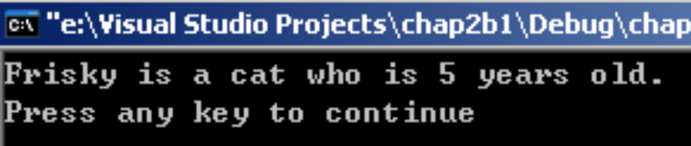
Private Versus Public
#include <iostream> // for cout
using namespace std;
class Cat // declare the class
{
public:
int itsAge;
int itsWeight;
};
int main()
{
Cat Frisky;
Frisky.itsAge = 5; // assign to the member variable
cout << "Frisky is a cat who is ";
cout << Frisky.itsAge << " years old.\n";
return 0;
}
Now itsWeight and itsAge are public members. They can be accessed by main().

Slide 16
How Private Variables Are Used?
#include <iostream> // for cout
using namespace std;
class Cat // declare the class Cat
{
public: void SetAge (int age);
int GetAge();
void SetWeight (int weight);
int GetWeight();
private: int itsAge;
int itsWeight;
};
int Cat::GetAge()
{ return itsAge;
}
void Cat::SetAge(int age)
{ itsAge = age;
}
Public Accessor Methods
Read/write
Private member variables
Accessor methods provide access to private members since they are in the same class

Slide 17
Class Interface Diagram
Time class
Set
Private data:
hrs
mins
secs
Increment
Write
Time
Time
Notes:
Operations vs. Data

Slide 18
Objects
Object:
  a variable or an instance of a class
Declaration of an Object
Initiation of an Object

Slide 19
What is an object?
OBJECT
set of methods
(public member functions)
internal state
(values of private data members)
Operations
Data

Slide 20
Declaration of an Object
class Rectangle
{
private:
int width;
int length;
public:
void set(int w, int l);
int area();
};
main()
{
Rectangle r1;
Rectangle r2;
r1.set(5, 8);
cout<<r1.area()<<endl;
r2.set(8,10);
cout<<r2.area()<<endl;
}

Slide 21
Another Example
#include <iostream.h>
class circle
{
private:
double radius;
public:
void store(double);
double area(void);
void display(void);
};
  // member function definitions
  void circle::store(double r)
  {
  radius = r;
  }
  double circle::area(void)
  {
  return 3.14*radius*radius;
  }
  void circle::display(void)
  {
  cout << “r = “ << radius << endl;
  }
  int main(void) {
  circle c; // an object of circle class
  c.store(5.0);
  cout << "The area of circle c is " << c.area() << endl;
  c.display();
  }

Slide 22
Array of objects
Arrays of variables of type "class" is known as "Array of objects".
The "identifier" used to refer the array of objects is an user defined data type.

Slide 23
Program for array of objects
#include <iostream.h>
const int MAX =100;
class Details
{
private: int salary;
float roll;
public:
void getdetails( )
{
cout << "\n Enter the Salary:";
cin >> salary;
cout << "\n Enter the roll:";
cin >> roll;
}
void putdetails( )
{
cout << "Employees" << salary <<"and roll is" << roll << '\n';
}
};

Slide 24
Program for array of objects (cont…)
void main()
{
Details det[MAX];
int n=0;
char ans;
do{
cout << "Enter the Employee Number::" << n+1;
det[n++].getdetails;
cout << "Enter another (y/n)?: " ;
cin >> ans;
} while ( ans != 'n' );
for (int j=0; j<n; j++)
{
cout << "\nEmployee Number is:: " << j+1;
det[j].putdetails( );
}
}

Slide 25
Outputs
Enter the Employee Number:: 1
Enter the Salary:20
Enter the roll:30
Enter another (y/n)?: y
Enter the Employee Number:: 2
Enter the Salary:20
Enter the roll:30
Enter another (y/n)?: n

Slide 26
Friend Function
A friend function of a class is defined outside that class' scope but it has the right to access all private and protected members of the class.
Even though the prototypes for friend functions appear in the class definition, friends are not member functions.
To declare a function as a friend of a class, precede the function prototype in the class definition with keyword friend as follows:
class Box
{
double width;
public: double length;
friend void printWidth( Box box );
void setWidth( double wid );
};

Slide 27
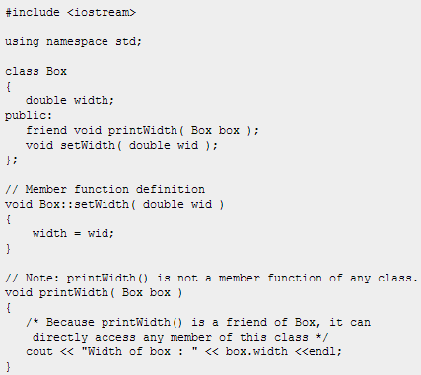
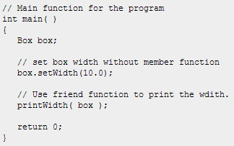
Output

Slide 28
Take Home Message
Class can be considered as a user-defined data type, while an object is just a variable of certain class.
There are three parts in the definition of a class: data members, member functions, and access control.

Slide 29
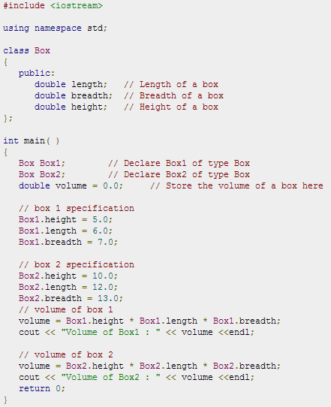


Slide 30
